Slide 1
CSE 442/542– Software Engineering Concepts
Prof. Matthew Hertz Davis 338L/ 645-4736 mhertz@buffalo.edu

Slide 2
Expectations of You
Conduct yourself as a professional
Work hard in VERY truncated course (6 weeks!)
Ask for help whenever you need it

Slide 3
Expectations of You
Conduct yourself as a professional
Work hard VERY truncated course (6 weeks!)
Ask for help whenever you need it
Let me know what you are thinking
If it helps you learn, I will adapt my approach
Cannot change until I understand problem

Slide 4
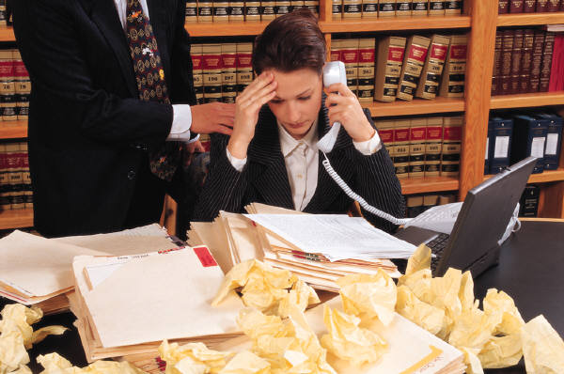
Professional Conduct
Disagreements happen on every project
One course goal is for you learn teamwork
Constant agreement is a problem; it means nobody cares
May care too much; always fighting also unproductive
Talk early and often; problems solvable when small
Sometimes must involve boss, but use me as last resort

Slide 5
Attendance
First job usually includes 2 weeks vacation
We only have 6 weeks, so need to attend all classes
Excused absences are… excused; do not infect class
But each unexcused absences reduces grade one-step
Not fair to group if you always miss work time
Impolitic to show up boss; 2 tardy arrivals = absence
Attendance is still mandatory
Talk to me as soon as you know you must miss a class
You are responsible for every class

Slide 6
Deadlines
Companies consider on-time bids only
Bid submission sites shutdown at deadline
Systems designed to prevent accepting late bids
Late submission impossible -- 1 second late or 1 week late
Submit work by time it is due
Made somewhat easier because deadlines will be in class
Cannot delay meeting to finish work; must be prepared
Communicate within your group all the time
Member being sick may or may not not be valid excuse

Slide 7
Lecture Slides
Slides contain more pictures, less text
Makes lectures more interesting & fun to attend
Can use more ways to reinforce lessons
Proper presentation techniques modeled in class
Slide deck posted to webpage before class
Includes PDF with space on side for notes
Using these can help you focus notes on key details
www.cse.buffalo.edu/~mhertz/courses/cse542

Slide 8
Readings
Material on web supplement lectures
Links to readings found on course schedule
Readings highly encouraged but not tested so…
Variety of sources and pages for these links
Many practitioner stories, blog entries, & articles
Pictures & YouTube videos also included
Enables covering topics common in industry
Much more interesting than any existing textbook

Slide 9
Course Website
www.cse.buffalo.edu/~mhertz/courses/cse542
Reading links, slides, project notes will be posted
Can also be find course syllabus & other materials
May not include everything said in class
Better than nothing, but worse than being here!
Notes:
Demo pages found on Angel before quitting

Slide 10
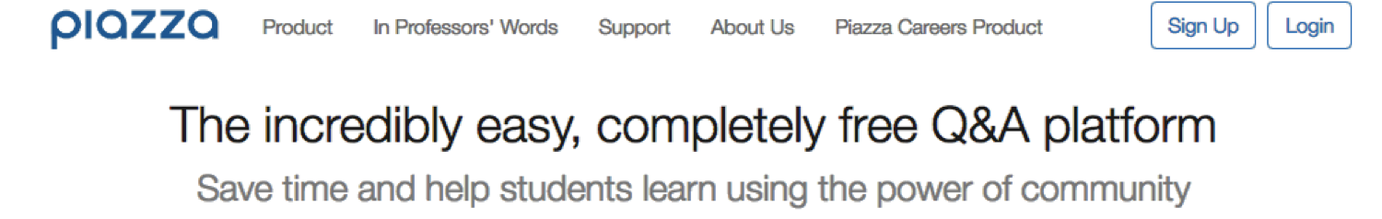
Using Piazza for forums and power group projects
Allows you to easily ask questions of instructor
I can post material for commonly asked questions
Even creates forums for students to talk to each other
Cost is ideal – free for both school and students
But it does first require you sign up on their site:
http://piazza.com/buffalo/summer2017/cse542
Notes:
DIscuss that anonymous posting is possible BUT that the TAs and I could find out who wrote a post if this gets abused.

Slide 11
Course Grading
This class only 11 meetings over the 6 weeks
Material important, but cannot overload students
Quizzes
Midterm
Final
Homework
Course Project

Slide 12
Course Grading
This class only 11 meetings over the 6 weeks
Material important, but cannot overload students
Different rules in summer, must rely upon your maturity
Class time = short lecture + work on term project
Quizzes | 0%
Midterm | 0%
Final | 0%
Homework | 0%
Course Project | 100%

Slide 13
Course Project
Give you opportunity to put ideas into practice
Work in teams of 3 or 4 developing solution over term
Emphasis on common practices; use real-world tools
Very truncated timeline to cover work done over term
State regulations: 12 – 16 hours working outside of class
As will see later, good situation for agile practices
Will be completing 4 sprints to complete project
Practices & tool use matter: not just about code
Marketing also important: sales presentation in week 5

Slide 14
Course Project Deadlines
Sprint results presented to instructor in-class
Sprint 1: Due June 8 – worth 20% of grade
Sprint 2: Due June 15 – worth 25% of grade
Sprint 3: Due June 22 – worth 25% of grade
Sprint 4: Due July 6 – worth 20% of grade
Will explain more how submission work on Thursday
"Trade show presentation" on June 29 & worth 10%
Discuss in more detail as we get closer to that time

Slide 15

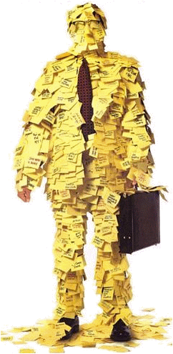
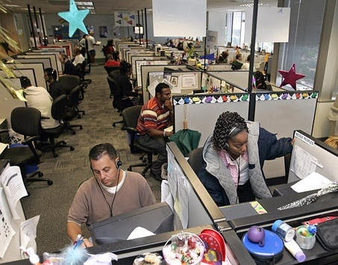
Reason Not To Study
Will not help if your goal is:

Slide 16
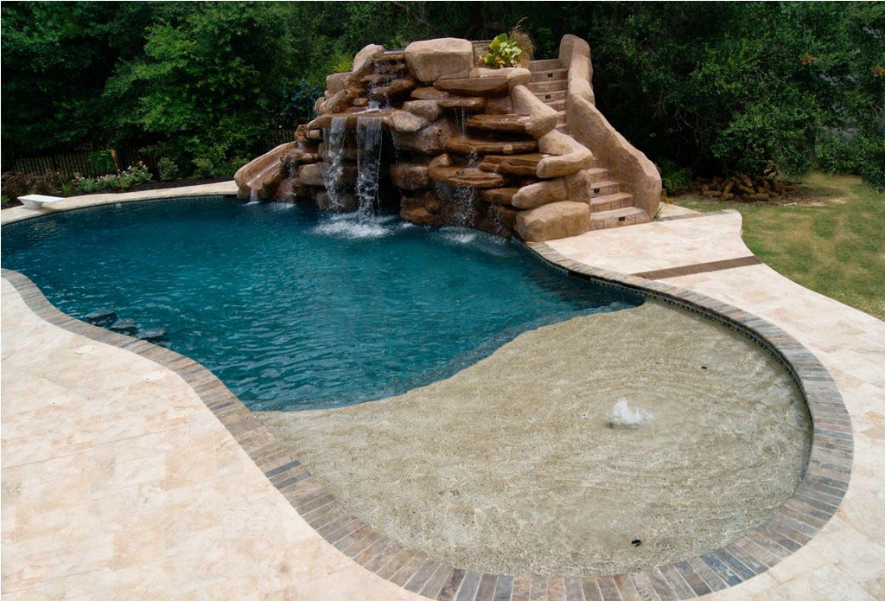
Reason To Study
Will help if your goal is:

Slide 17
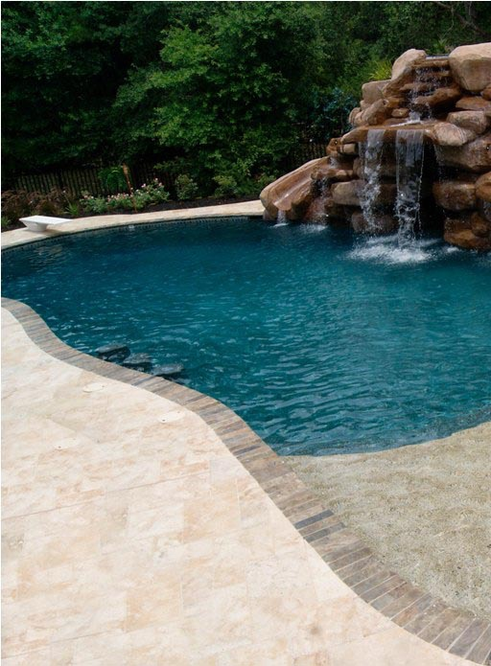
Reason To Study
Will help if your goal is:
Software Engineers earn $11,000/year more

Slide 18
Why Software Engineering?

Slide 19
Why Software Engineering?
Everyone sucks
at building software

Slide 20

“A journey begins with a single step”
Notes:
We would like to think of things like this…

Slide 21
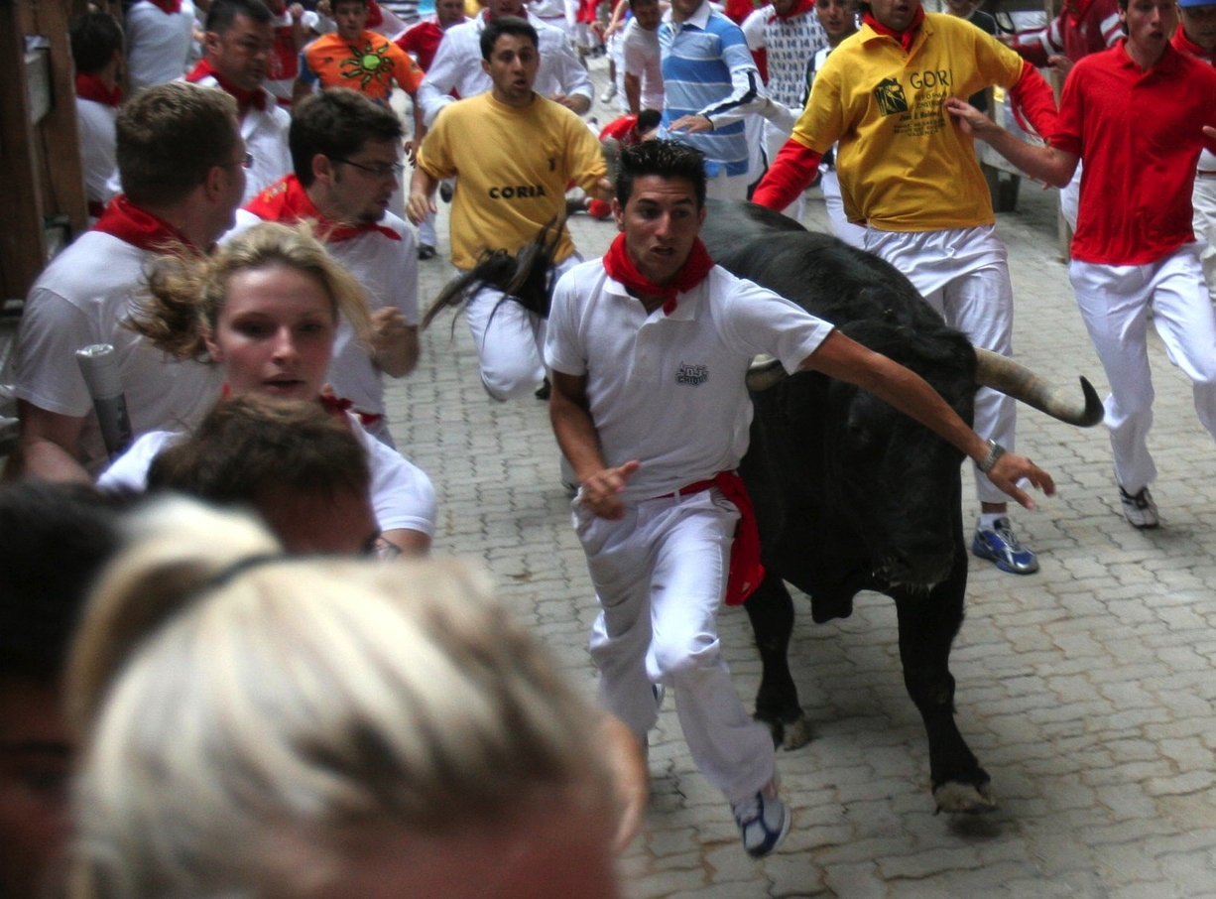
“A journey begins with a single step”
Notes:
… but most software projects are much more like this

Slide 22

“A journey begins with a single step”
Notes:
… but most software projects are much more like this

Slide 23
Software Engineering Defined
[D]iscipline trying to produce software that is:
Free of any bugs, defects, errors, or faults
Delivered on time & within budget
Satisfies the client’s needs
Must be easy to modify
Adaptable to changing needs of the user
(adapted from Schach, Object-Oriented & Classical Software Engineering, 2007)

Slide 24
Software Engineering Defined
[D]iscipline trying to produce software that is:
Free of any bugs, defects, errors, or faults
Delivered on time & within budget
Satisfies the client’s needs
Must be easy to modify
Adaptable to changing needs of the user
(adapted from Schach, Object-Oriented & Classical Software Engineering, 2007)

Slide 25
“Free of Bugs”
Finding bugs important first step for process
Worst approach: have people test own documents
Admit sabotage or assume correct: is this a choice?
When do developers ever admit to a defect?

Slide 26
“Free of Bugs”
Finding bugs important first step for process
Worst approach: have people test own documents
Admit sabotage or assume correct: is this a choice?
When do developers ever admit to a defect?
Could create reward for each bug found and fixed

Slide 27
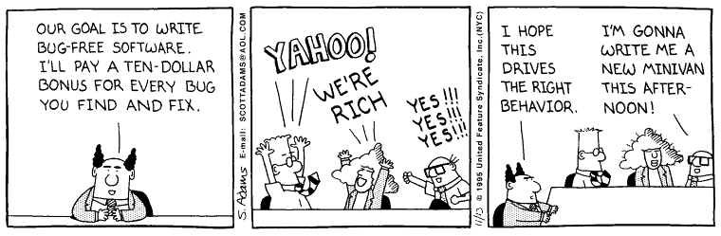
“Free of Bugs”
Finding bugs important first step for process
Worst approach: have people test own documents
Admit sabotage or assume correct: is this a choice?
When do developers ever admit to a defect?
Could create reward for each bug found and fixed

Slide 28
“Free of Any Bugs”
Who gets to decide?

Slide 29

“Free of Any Bugs”
Who gets to decide?

Slide 30
Testing Teams
Testing is a skill like any other
Requires practice, persistence, & talent
Skilled testers needed for project to work correctly
Important that testers be encouraged & rewarded
Cannot punish people for defects in their work
But reporting errors is critical for testing to work
Cannot reward people for lack of defects in work
Reporting ALL errors is critical for testing to work

Slide 31
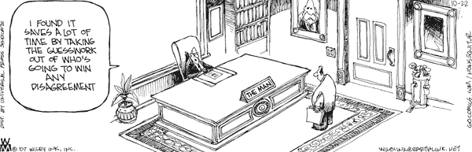
Testing Teams
Cannot win argument with boss
Executives will always have final say
Direct projects & make salary decisions

Slide 32
Testing Teams
Cannot win argument with boss
Executives will always have final say
Direct projects & make salary decisions
Managerial independence critical
Bugs, faults, & errors are part of process
Testing team must be free to make decisions
Politics or friendship should not bias their work

Slide 33
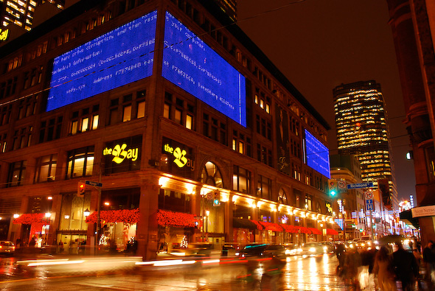
Software Engineering Role
Develop, implement, & evaluate
Quality Control Procedures

Slide 34
Software Engineering Defined
[D]iscipline trying to produce software that is:
Free of any bugs, defects, errors, or faults
Delivered on time & within budget
Satisfies the client’s needs
Must be easy to modify
Adaptable to changing needs of the user
(adapted from Schach, Object-Oriented & Classical Software Engineering, 2007)

Slide 35
Software Engineering Defined
[D]iscipline trying to produce software that is:
Free of any bugs, defects, errors, or faults
Delivered on time & within budget
Satisfies the client’s needs
Must be easy to modify
Adaptable to changing needs of the user
(adapted from Schach, Object-Oriented & Classical Software Engineering, 2007)

Slide 36
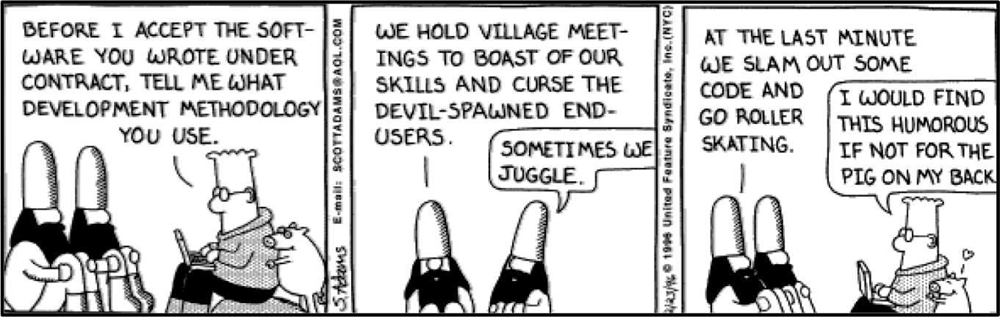
“On Time”
How do we keep to accepted timelines?

Slide 37
“On Time & Under Budget”
Software can be made:
Good
Fast
Cheap

Slide 38
“On Time & Under Budget”
Software can be made:
Good
Fast
Cheap
Pick two

Slide 39
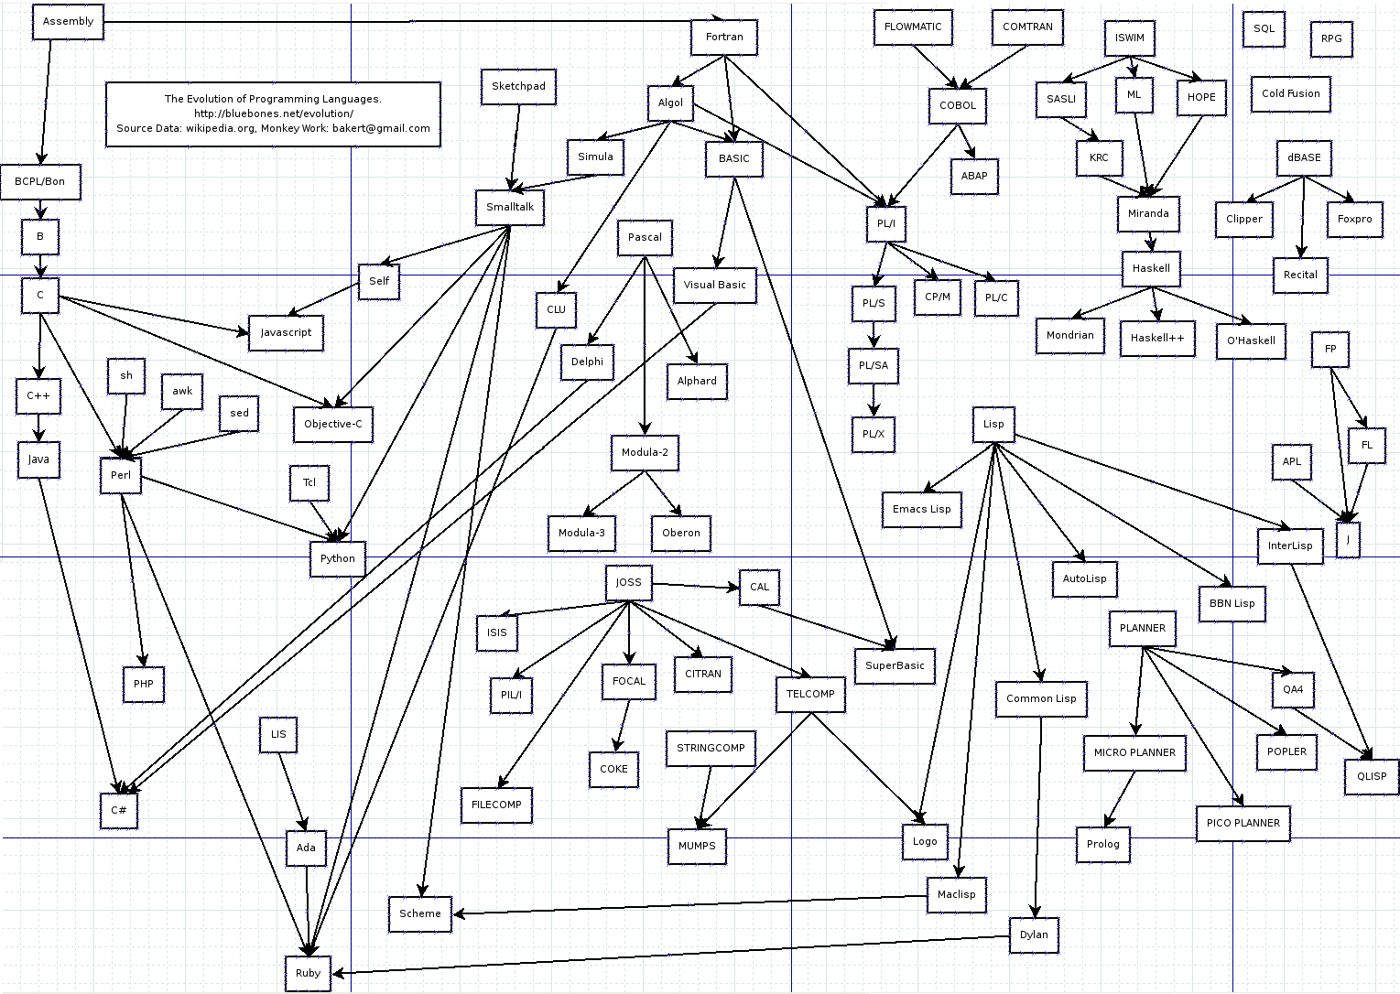
Software Engineering Role
Evaluate & select tools that team will use:
Manage Software Lifecycle

Slide 40
Software Engineering Defined
[D]iscipline trying to produce software that is:
Free of any bugs, defects, errors, or faults
Delivered on time & within budget
Satisfies the client’s needs
Must be easy to modify
Adaptable to changing needs of the user
(adapted from Schach, Object-Oriented & Classical Software Engineering, 2007)

Slide 41
Software Engineering Defined
[D]iscipline trying to produce software that is:
Free of any bugs, defects, errors, or faults
Delivered on time & within budget
Satisfies the client’s needs
Must be easy to modify
Adaptable to changing needs of the user
(adapted from Schach, Object-Oriented & Classical Software Engineering, 2007)

Slide 42
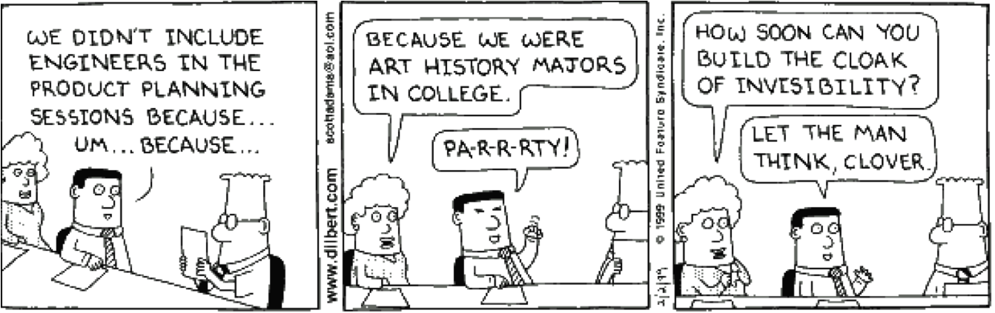
“Satisfy the Client”
Customer’s ideas often interesting…

Slide 43
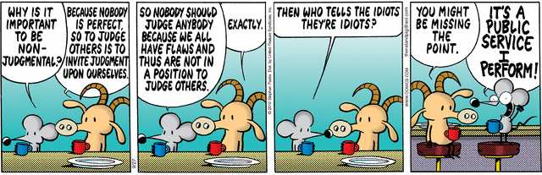
“Satisfy the Client”
Customer’s ideas often interesting…

Slide 44
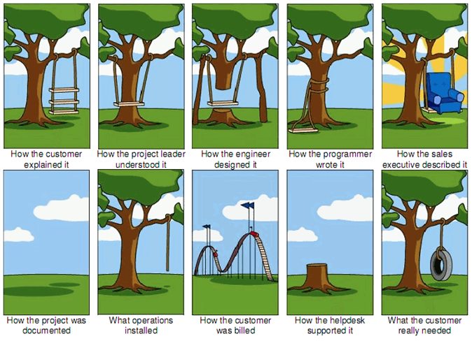
Software Engineering Role
Enable communication between all parties:
Knowledge Management tools

Slide 45
Software Engineering Defined
[D]iscipline trying to produce software that is:
Free of any bugs, defects, errors, or faults
Delivered on time & within budget
Satisfies the client’s needs
Must be easy to modify
Adaptable to changing needs of the user
(adapted from Schach, Object-Oriented & Classical Software Engineering, 2007)

Slide 46
Software Engineering Defined
[D]iscipline trying to produce software that is:
Free of any bugs, defects, errors, or faults
Delivered on time & within budget
Satisfies the client’s needs
Must be easy to modify
Adaptable to changing needs of the user
(adapted from Schach, Object-Oriented & Classical Software Engineering, 2007)

Slide 47
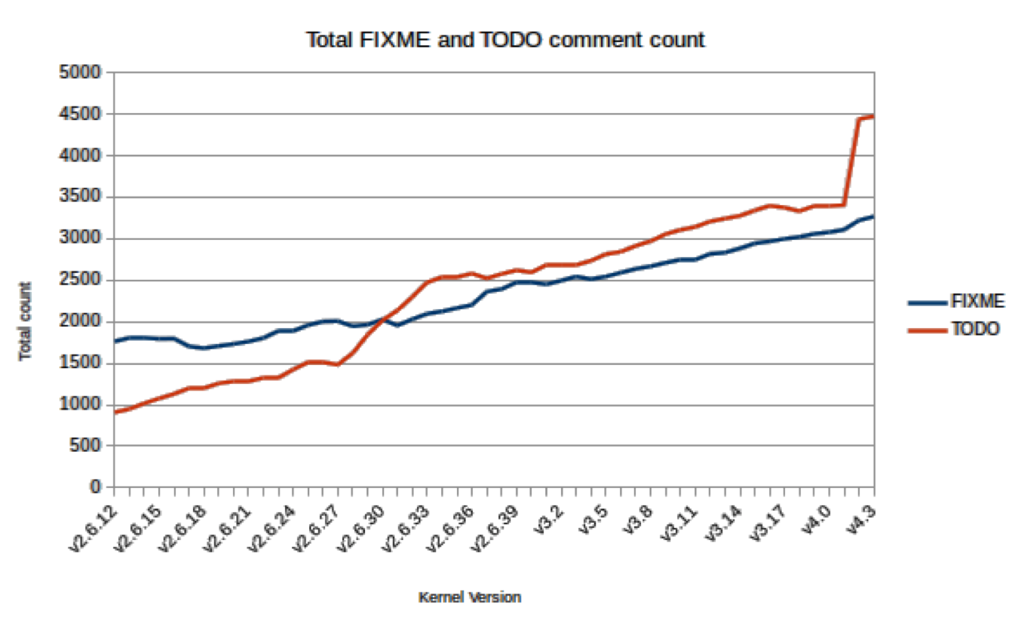
“Easy To Modify”

Slide 48
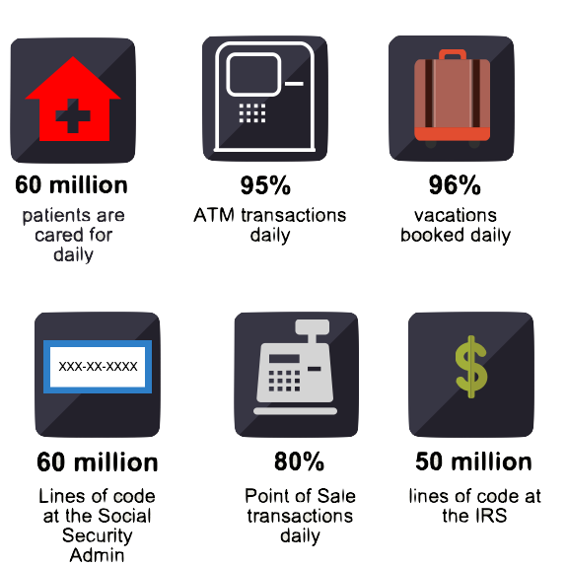
“Easy To Modify”
Cobol Code

Slide 49
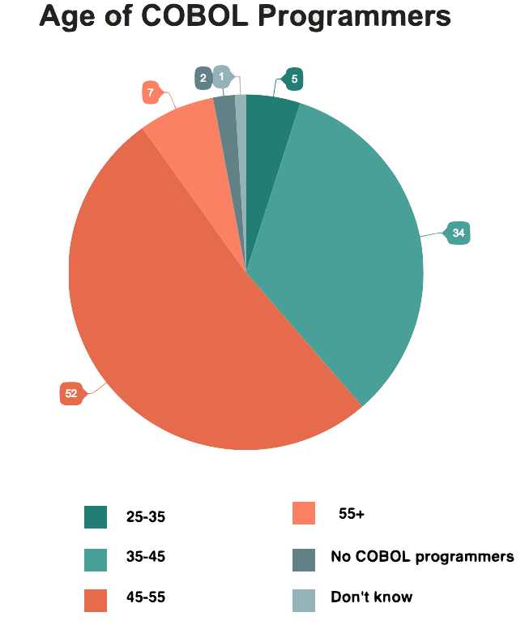
“Easy To Modify”
Cobol Code
Cobol Programmers

Slide 50
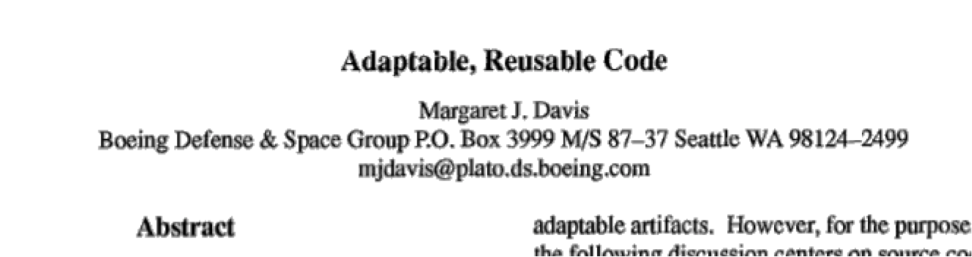
Software Engineering Role
Develop ways to communicate what the code does:
Software Designs and Code Management

Slide 51
Software Engineering Defined
[D]iscipline trying to produce software that is:
Free of any bugs, defects, errors, or faults
Delivered on time & within budget
Satisfies the client’s needs
Must be easy to modify
Adaptable to changing needs of the user
(adapted from Schach, Object-Oriented & Classical Software Engineering, 2007)

Slide 52
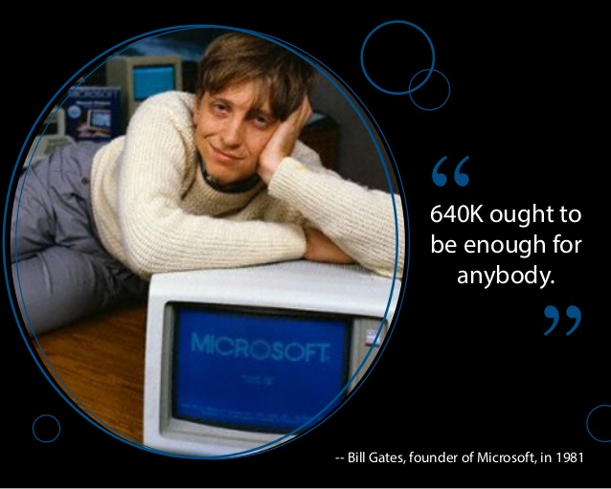
“Adaptable to Chang[e]”

Slide 53
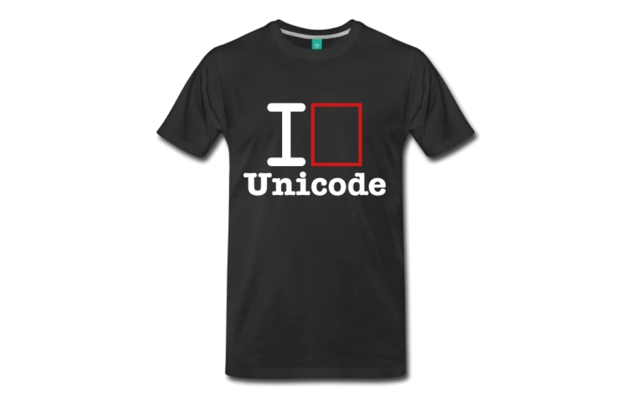
“Adaptable to Chang[e]”

Slide 54
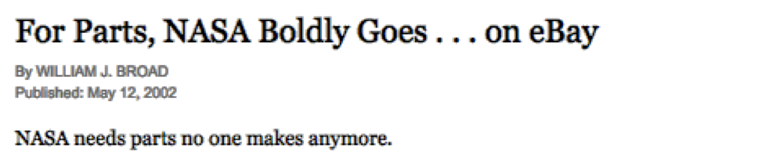
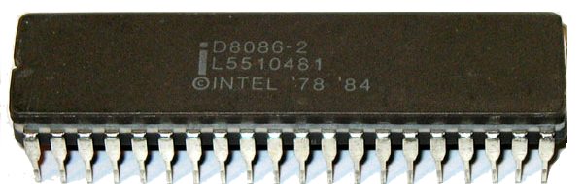
“Adaptable to Change”

Slide 55
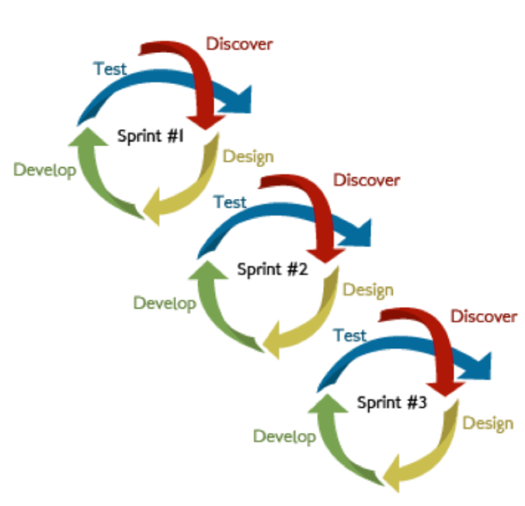
Software Engineering Role
Select long-term management approaches
Software Lifecycle and Project Management

Slide 56
Programming is Important
“Software construction is the central activity… the only activity guaranteed to happen.”
Code is THE main deliverable to customer
Code is unimportant to customers; they do not care
Do care about: GUI, manuals, distribution media, …
Could code be our only focus?

Slide 57
Correctness Proofs
Can the hard parts be automated?
Use system automatically prove program correctness
Check client requests to see if complete & sound
Would need to develop mathematical proof
Relies on creating & understanding proof
Proofs rarely read for pleasure or taken to the beach
Only as valuable as proof is correct
Faith in the proof further limits its value

Slide 58
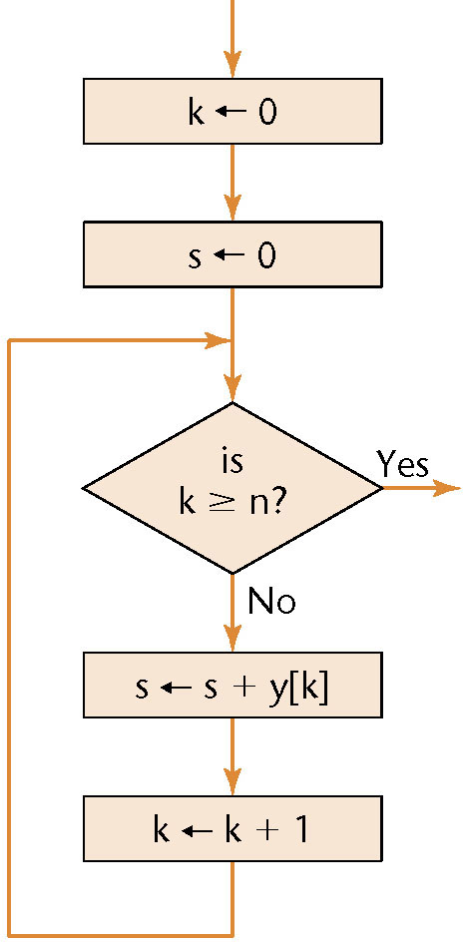
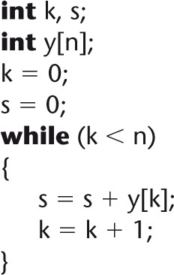
Correctness Proof
Begin by creating flowchart of process
Process is code, design, use case, …

Slide 59
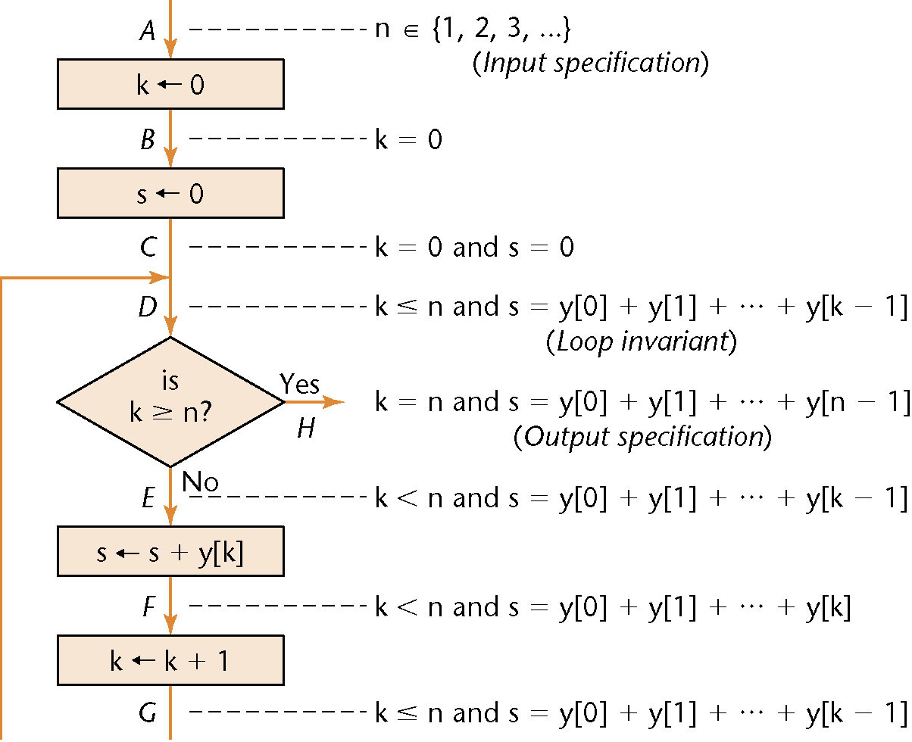
Correctness Proof
Should then add
I/O specification
Assertions
Other details
Developing is as much art as science

Slide 60
Two Myths
Costs way, WAY, WAY too much
Use sparingly, but worth it in some situations
Proofs are too fucking hard
Note: they able to prove code in space shuttle correct
Theorem proofers can help automate process

Slide 61
Two Myths
Costs way, WAY, WAY too much
Use sparingly, but worth it in some situations
Proofs are too fucking hard
Note: they able to prove code in space shuttle correct
Theorem proofers can help automate process
But what if the theorem proofers has a bug?

Slide 62
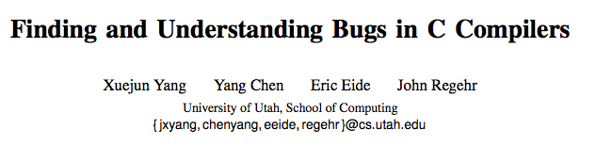
Where Can We Stop Proof?
What do we need to prove? Program relies upon
Compiler which converts code to executable

Slide 63
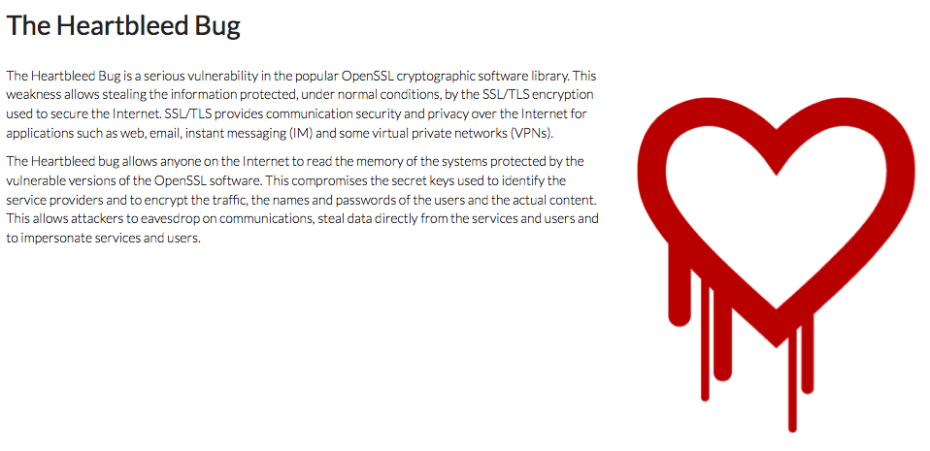
Where Can We Stop Proof?
What do we need to prove? Program relies upon
Compiler which converts code to executable
Prebuilt libraries that will be used by program

Slide 64
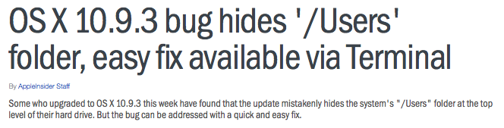
Where Can We Stop Proof?
What do we need to prove? Program relies upon
Compiler which converts code to executable
Prebuilt libraries that will be by program
Operating system on which program is run

Slide 65
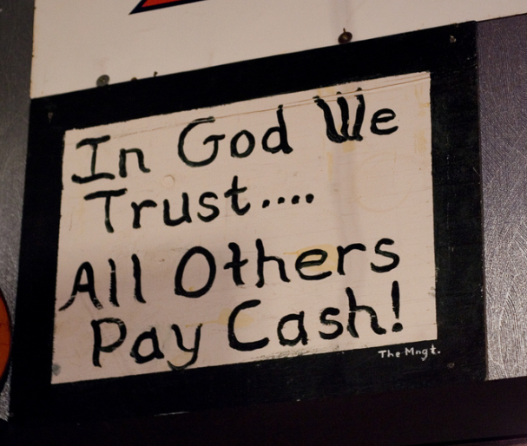
Where Can We Stop Proof?
What do we need to prove? Program relies upon
Compiler which converts code to executable
Prebuilt libraries that will be by program
Operating system on which program is run
Hardware executing machine code for program
Bug could be introduced by any of these!

Slide 66
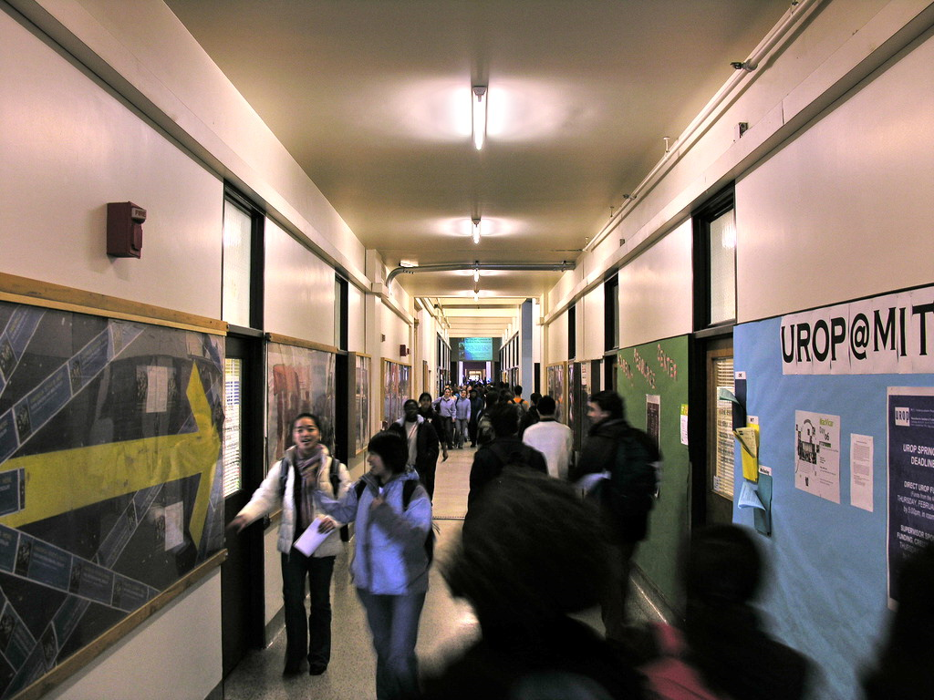
Bigger Problem
Idea ends with “Halting Problem”
Turing machine checks will a program using input halt
But cannot find answer for all machines & inputs
Creates some major software engineering issues
Notes:
Insolvability of the Halting problem proven using a machine which takes a program and the input program’s input
The failing machine goes into an infinite loop if the input program will terminate and returns true if it will not terminate.
Now feed our universal halting detector this machine as its input program and for our trick program’s input give it the universal halting detector as both sides. For this machine to halt, the universal halting detector must be unable to halt.

Slide 67
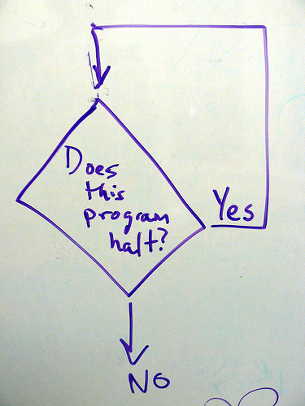
Not Fully Automatable
Cannot guarantee automated solution works
Even for specific input, cannot provide program ends
Impossible to find bug if program not supposed to end

Slide 68

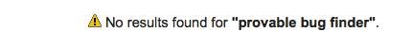
Not Fully Automatable
Cannot guarantee automated solution works
But for some (most) cases working prover possible
Still expensive to run, especially given these issues
Issue will be recurring problem for automation

Slide 69
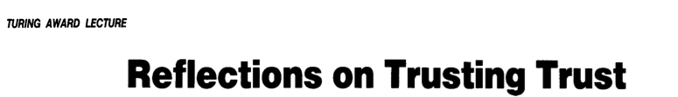
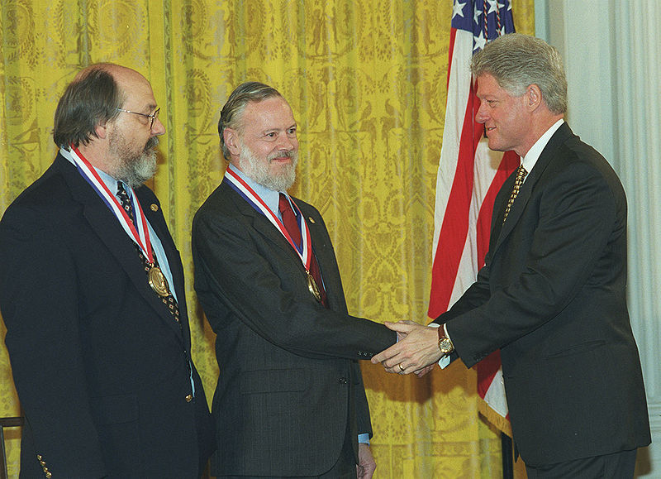
Not Fully Automatable
Show “trust” problem fails using similar approach
How to do we know prover does not contain bug?
Could it not terminate but still be bug free?

Slide 70
Take 5

Slide 71
Lies, Darned Lies & Metrics
Person-year common measure of work performed
Work done by 1 person over 1 year
12 people in 1 month also a person-year of work
Or 4 people in 2 months + 1 person in 4 months

Slide 72
Lies, Darned Lies & Metrics
Person-year common measure of work performed
Work done by 1 person over 1 year
12 people in 1 month also a person-year of work
Or 4 people in 2 months + 1 person in 4 months
Among the stupidest metrics ever & ever
Often see coders’ productivity vary by 10x
Ignores meetings, sick days, hangovers in calculation
Can do a lot more in an 8-hour day vs. 8 1-hour days

Slide 73


Do Person-Months Scale?
9 x 1 Month of Work

Slide 74
Do Person-Months Scale?
9 x 1 Month of Work
1 x 9 Months of Work

Slide 75

Do Person-Months Scale?
9 x 1 Month of Work
1 x 9 Months of Work
Notes:
According to my wife (aka the local expert), it is far better to be pregnant for 9 months than to recruit 8 friends and only be pregnant for one month.
Like she'd know anything after month 6.

Slide 76
Computer Science “Laws”
Name for folk wisdom built up over years
Weinberg’s Second Law
If builders built buildings the way programmers wrote programs, the 1st woodpecker […] would destroy civilization.
Brook’s Law
Adding programmers to a team when a product is late makes the product even later.

Slide 77
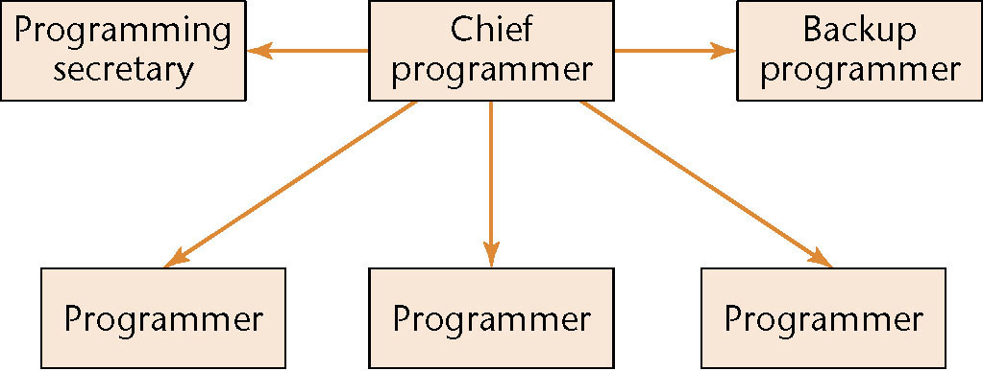
Chief Programmer Team
Productivity improved by limiting communication
Everything is chief programmer’s responsibility
Notes:
First used in 1971 by IBM on a project automating the storage and retrieval from the NYTimes clippings file.
The project took slightly under 2 years, with the coding primarily occurring in the 6 months.
Over the first year (including the testing cycle) only 46 faults (“bugs”) were found.
Project was live for several decades not until 90s – 00s was it replaced (source?)

Slide 78

Chief Programmer Team
Productivity improved by limiting communication
Everything is chief programmer’s responsibility
Notes:
Programming secretary (librarian)
Maintains all documents and deliverables
Responsible for repository maintenance
Content to spend all day doing paperwork
Compiled, linked, & tested code (this was 1971)

Slide 79
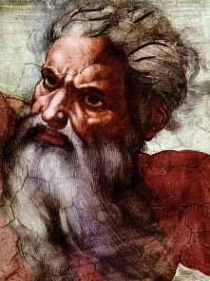
Chief Programmer Team
Productivity improved by limiting communication
Everything is chief programmer’s responsibility
Notes:
Chief programmer
Successful manager and programmer
Responsible for every line of code
Performs architectural design, allocates coding, heals the sick, writes critical sections, handles interfaces, teaches cats to sing, performs all reviews, and blends in with mere mortals
This was “superprogrammer” F. Terry Baker on the NYTimes project

Slide 80
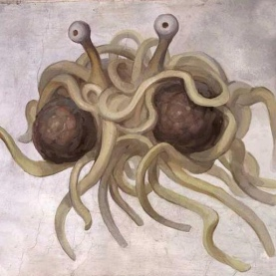
Chief Programmer Team
Productivity improved by limiting communication
Everything is chief programmer’s responsibility
Notes:
Back-up programmer
Takes over if/when Chief Programmer is out
For unknown reasons, does not leave for big $$$

Slide 81
Chief Programmer Team
Productivity improved by limiting communication
Everything is chief programmer’s responsibility
Notes:
Programmers
Write code
Write more code

Slide 82
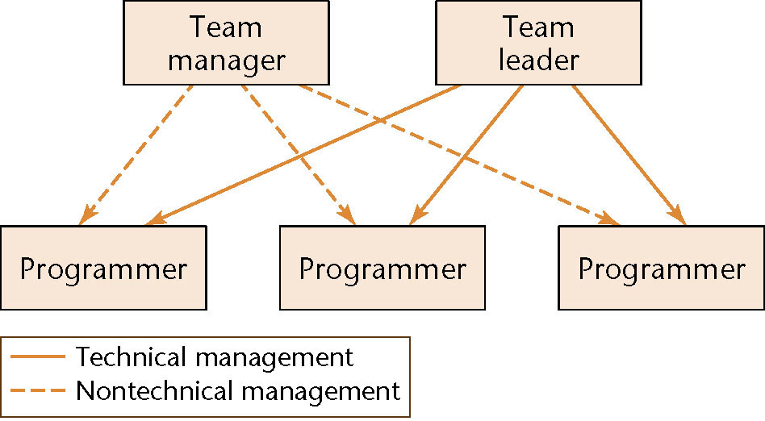
Teams in the Real World
Needs to consider reality of you mortals
Work done by chief programmer is split
Managerial & technical roles separated

Slide 83
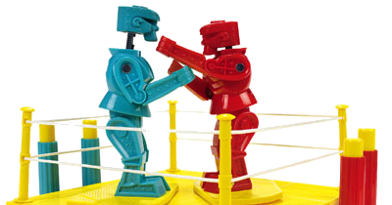
Teams in the Real World
Needs to consider reality of you mortals
Work done by chief programmer is split
Managerial & technical roles separated

Slide 84
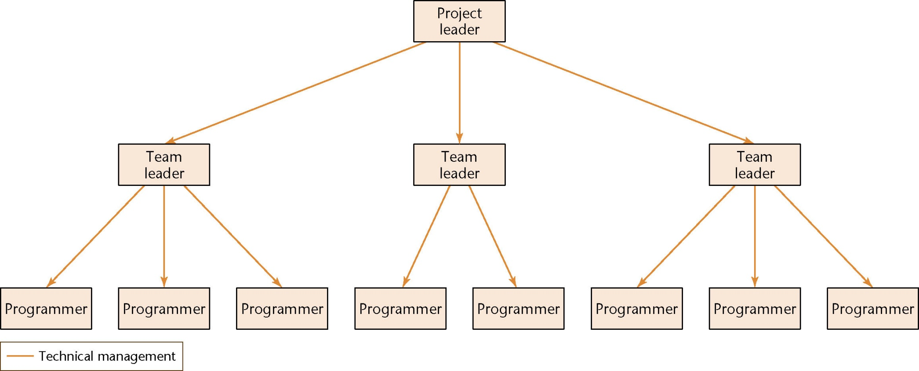
Teams In The Real World
Scale to larger teams of 20 - 120 programmers
Whenever necessary, add more layers

Slide 85

Teams In The Real World
Scale to larger teams of 20 - 120 programmers
Whenever necessary, add more layers

Slide 86
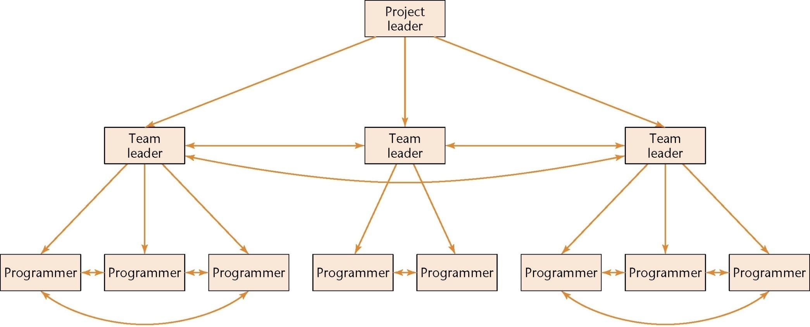
Democracy InAction
Limit politics using teams and group concepts

Slide 87
Democracy InAction
Limit politics using teams and group concepts
Worst of the in-fighting prevented

Slide 88
Democracy InAction
Limit politics using teams and group concepts
Worst of the in-fighting prevented by meetings

Slide 89
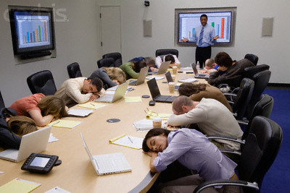
Democracy InAction
Limit politics using teams and group concepts
Worst of the in-fighting prevented by meetings

Slide 90
Synchronize-and-Stabilize
Used by Microsoft (& adapted for open-source)
Teams of 3 – 8 developers (& 3 – 8 testers for Microsoft)
Team owns entire task; responsibility shared equally
Work from specification through implementation
Regular synchronization & testing key to process
Tests that day’s code to report all errors across project

Slide 91

Synchronize-and-Stabilize
Used by Microsoft (& adapted for open-source)
Teams of 3 – 8 developers (& 3 – 8 testers for Microsoft)
Team owns entire task; responsibility shared equally
Work from specification through implementation
Regular synchronization & testing key to process
Tests that day’s code to report all errors across project
Great hackers: common trait for Microsoft & Linux

Slide 92
Democratic Teams
Programmers have egos that are very healthy

Slide 93
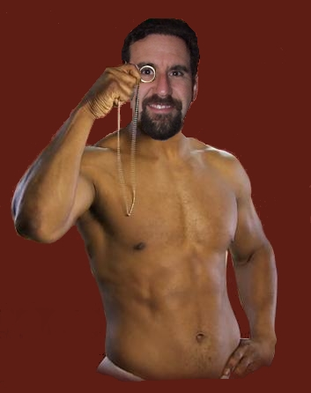
Democratic Teams
Programmers have egos that are very healthy:

Slide 94
Democratic Teams
Programmers have egos that are very healthy:
Computers & algorithms often eponymous
Fixing errors is difficult: “Cannot be in MY code!”
Instead rely on egoless programming

Slide 95
Egoless Programming
Team emphasis to all activities
Team as a whole owns all code
Errors are acceptable events to be fixed
Entire team responsible for finding & fixing bugs
Seen as singular group internally & externally

Slide 96
Egoless Programming
Team emphasis to all activities
Team as a whole owns all code
Errors are acceptable events to be fixed
Entire team responsible for finding & fixing bugs
Seen as singular group internally & externally
Hard to create, but can arise organically
Up to 10 egoless programmers form into group
Often when there is nothing to gain personally
Academia & agile teams most often rely on approach

Slide 97
Egoless Programming
Team emphasis to all activities
Team as a whole owns all code
Errors are acceptable events to be fixed
Entire team responsible for finding & fixing bugs
Seen as singular group internally & externally
Hard to create, but can arise organically
Up to 10 egoless programmers form into group
Often when there is nothing to gain personally
Academia & agile teams most often rely on approach
Double-bonus for use in software engineering course

Slide 98
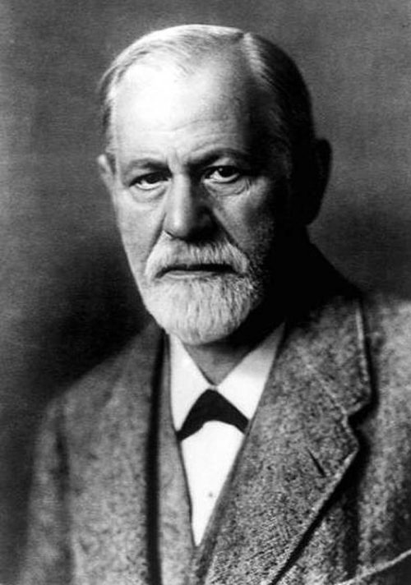
Choosing Team Organization
Exceedingly little study of team organization
Instead rely on general group dynamic research
Woo-hoo! Psychology texts to read
Software engineering use faces two big issues
Psychology texts are boring; very, very, very, very, very boring
Software engineers rarely trained in psychology

Slide 99

Choosing Team Organization
In real world, optimal approach does not exist
Depend on situation & people included on team
Organizational approach can be changed to fit people
Or change people to fit team organization
Scientifically team dynamics difficult to analyze
Hard to set-up experiments that could do this well
Trying to control these experiments may be unethical

Slide 100

Meet Your Classmates

Slide 101
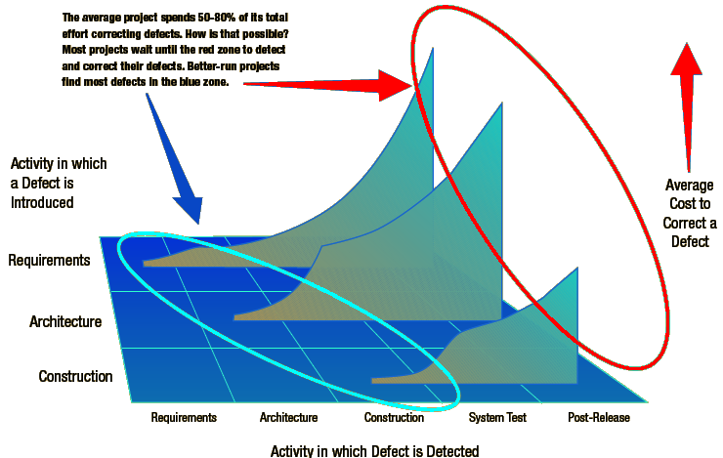
Why Lifecycle Matters

Slide 102
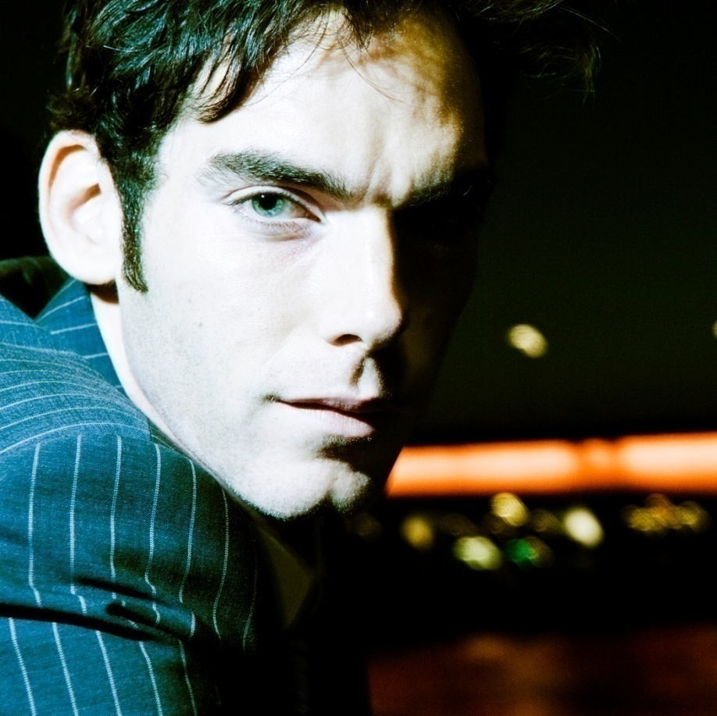

Why Do Models Matter?
Client has 2 programmers with different styles
Bob
Joe

Slide 103


Why Do Models Matter?
More about Bob & Joe…
Bob codes like Joe paid attention & like he did in college uses real lifecycle model

Slide 104
Why Do Models Matter?
Both look over notes handed by project executive
Bob then writes test cases then starts coding
Joe determines client’s needs in meetings
%Complete | Bob |  | Joe
 | Work (in $) | Rework (in $) | Work (in $) | Rework (in $)
20% | $100,000 | $0 | $150,000 | $0
Total | $100,000 | $0 | $150,000 | $0

Slide 105
Why Do Models Matter?
Bob often duplicates code, but with minor tweaks
Requires expensive reworking & slows progress
Joe creates design minimizing code needed
Finds & fixes bugs in client’s requirements
%Complete | Bob |  | Joe
 | Work (in $) | Rework (in $) | Work (in $) | Rework (in $)
20% | $100,000 | $0 | $150,000 | $0
40% | $100,000 | $20,000 | $100,000 | $10,000
Total | $200,000 | $20,000 | $250,000 | $10,000

Slide 106
Why Do Models Matter?
Bob works from scratch & does not reuse code
Lacks plan to incorporate existing code
Joe expands design to outline algorithms
Simple process finds majority of errors
Merges classes & simplify design when possible
%Complete | Bob |  | Joe
 | Work (in $) | Rework (in $) | Work (in $) | Rework (in $)
20% | $100,000 | $0 | $150,000 | $0
40% | $100,000 | $20,000 | $100,000 | $10,000
60% | $100,000 | $20,000 | $100,000 | $10,000
Total | $300,000 | $40,000 | $350,000 | $20,000

Slide 107
Why Do Models Matter?
Bob’s code is project-specific & cannot be reused
Getting concerned as project starts falling behind
Joe writes detailed test cases for system
Simple to do since all details worked out
%Complete | Bob |  | Joe
 | Work (in $) | Rework (in $) | Work (in $) | Rework (in $)
20% | $100,000 | $0 | $150,000 | $0
40% | $100,000 | $20,000 | $100,000 | $10,000
60% | $100,000 | $20,000 | $100,000 | $10,000
80% | $100,000 | $20,000 | $100,000 | $10,000
Total | $400,000 | $60,000 | $450,000 | $30,000

Slide 108
Why Do Models Matter?
Bob cannot provide details to get extra help
Lots of all-nighters needed to complete system
Joe’s coding is easy with well-defined tests
Farm animals could be used for this step
%Complete | Bob |  | Joe
 | Work (in $) | Rework (in $) | Work (in $) | Rework (in $)
20% | $100,000 | $0 | $150,000 | $0
40% | $100,000 | $20,000 | $100,000 | $10,000
60% | $100,000 | $20,000 | $100,000 | $10,000
80% | $100,000 | $20,000 | $100,000 | $10,000
100% | $150,000 | $20,000 | $50,000 | $10,000
Total | $550,000 | $80,000 | $500,000 | $40,000

Slide 109

Why Do Models Matter?
Bob cannot provide details to get extra help
Lots of all-nighters needed to complete system
Joe’s coding is easy with well-defined tests
Farm animals could be used for this step
%Complete | Bob |  | Joe
 | Work (in $) | Rework (in $) | Work (in $) | Rework (in $)
20% | $100,000 | $0 | $150,000 | $0
40% | $100,000 | $20,000 | $100,000 | $10,000
60% | $100,000 | $20,000 | $100,000 | $10,000
80% | $100,000 | $20,000 | $100,000 | $10,000
100% | $150,000 | $20,000 | $50,000 | $10,000
Total | $550,000 | $80,000 | $500,000 | $40,000

Slide 110


What’s The End Result?
Bob barely finishes
Most goals are met
Crashes occasionlly
GUI not like contract
Joe is tanned & rested
Fully meets needs
Reliable & robust
GUI mostly correct

Slide 111


What’s The End Result?
Bob barely completes
Most goals are met
Crashes on occasion
GUI not as wanted
Joe is tanned & rested
Fully meets needs
Reliable & robust
GUI mostly correct
Client fires them both
Cared about ORIGINAL GUI

Slide 112

Models Matter
Client valued GUI design highly
Joe and Bob both chose inappropriate models
But Joe gets better chair in unemployment
Only successful life cycle models survive
Nobody records failures or the merely adequate
But remember, there is no silver bullet…
Strengths & weaknesses to each model
Important to match tool to situation
New models fix weaknesses in existing approaches

Slide 113

Classroom Development
Always start from scratch
Requirements perfect from start
Work that must be done is clear
Coding begins immediately at start
Projects are trivial jokes for real-world
Longest project last at most 2 months
Ends total mess; cannot reuse code
Would never reuse, anyway

Slide 114
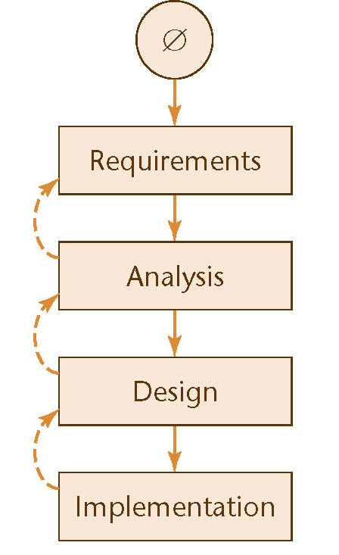
Waterfall Model
Original model of software lifecycle
Outlined steps that must happen
Project finished once shipped to client
Moves software to assembly line
Station-to-station travel of project
Model enables people to specializes
Set of deliverables created over step
Evidence & result of following process
Ends with baseline delivered to client
Contains complete set of documents

Slide 115
Waterfall Model
Original model of software lifecycle
Outlined steps that must happen
Project finished once shipped to client
Moves software to assembly line
Station-to-station travel of project
Model enables people to specializes
Set of deliverables created over step
Evidence & result of following process
Ends with baseline delivered to client
Contains complete set of documents
This means:
a) nobody likes it;
b) nobody can make it work; &
c) everybody can improve it.

Slide 116
Waterfall Model
Assumes project begins as clean slate
Ends once coded; no maintenance planned
Led to other name Big Bang approach
Unlikely ever this clean, especially now
Requirements begins with meetings
Only chance for client to provide input
Working together to define project
Ends with contract specifying result
Once contract signed, client goes away
No further interaction until delivery

Slide 117
Waterfall Model
Analysts use contract to develop ideas
Will create models, schema, business logic
But starts with check of contract
Looking for inconsistencies or ambiguities
Very limited window to flag mistakes
Hands results to the project design team
Design outlines code to be written
Specifies classes & routines needed
Can also include hardware architecture
Must fit models & schema from before
Often gets down to algorithmic level

Slide 118
Waterfall Model
Implementation is for the coders
Start with time to find design problems
Then match design in code written
Only job is to match design given them
Client returns at end to take baseline
Extremely efficient when it works
Revolutionary like Ford’s assembly line
Strengths used due to specialization
With all info, best decisions possible

Slide 119
Waterfall Model
Useful when:
Client knows what they need
Needs can be fully documented & described
Little-to-no interaction sought while developed
Large organization able to keep specialists
Maintenance & updates unimportant/not on the table
Not useful when:
You are developing products in the 21st century

Slide 120
Moving Target Problem
Requirements may change during development
Changes may be important, but…
…disrupts flow & introduce dependencies
Changes during process causes regression faults
Error (“fault”) occurs in an unrelated portion of project
These changes become major pain to fix
Faults will build up as changes continue
Eventually requires redesign & reimplementation

Slide 121
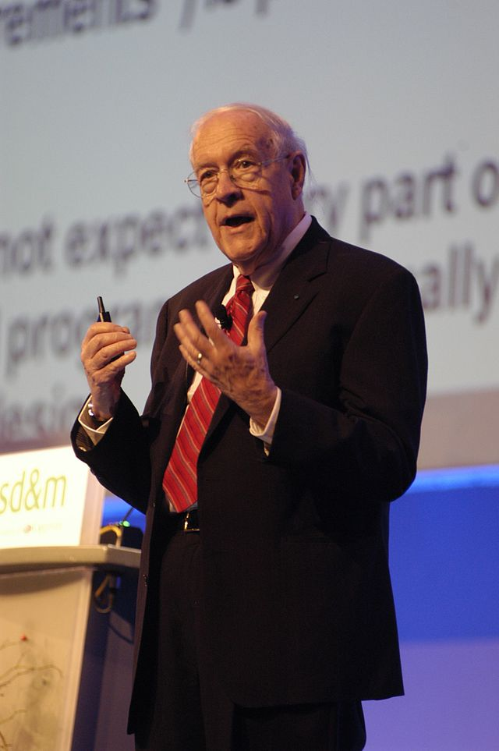
Waterfall Key Problem
Changeability is an essential difficulty with software
Waterfall assumes everything known at start
Fred Brooks

Slide 122

Rapid Prototyping
Create prototype after each step
to check requirements

Slide 123
Rapid Prototyping
Usability and looks are focus for rapid prototype
Provides limited ability for client to provide feedback
Functionality limited to basics (and often faked)
Any restarts take pieces back through full waterfall
Project feasibility unclear, since functionality left to end
Led to creation of VisualBasic and Oracle Forms
Lightweight tools emphasizing GUI functionality
Lousy languages with serious performance issues
Confusion creators, since clients “see” finished product

Slide 124

Spiral Lifecycle

Slide 125
Spiral Lifecycle
Useful for projects with unknown levels of risk
Functionality & feasibility key as opposed to looks
Uses waterfall ideas, but more cautious in execution
Each phase ends with estimate for client to review
If client like results and accepts risks, work continues
But okay to kill project when risks deemed too high
Very useful for exploratory or experimental work
Starts small and grows with time and confidence
Also can cause problems, since growth brings own risks

Slide 126

Change Is Inevitable

Slide 127
Rational Unified Process
Dominant method developing OO software
Methodology unifies work by “Three Amigos”
Not just a life cycle, really looks at all of software
Emphasis placed on making process rational
Coders need steps from the waterfall model
These steps are not what business cares about
Businesses are profit-making ventures only

Slide 128
Rational Unified Process
Dominant method developing OO software
Methodology unifies work by “Three Amigos”
Not just a life cycle, really looks at all of software
Emphasis placed on making process rational
Coders need steps from the waterfall model
These steps are not what business cares about
Businesses are profit-making ventures only
Code is NOT the goal!

Slide 129

Code is NOT the Goal!

Slide 130

Code is NOT the Goal!
Notes:
Translate my joke (which is really a song from before they were born) from American to European

Slide 131

Code is NOT the Goal!
Notes:
$100 is currently worth €77.23

Slide 132

RUP

Slide 133
RUP
Time
Work

Slide 134
RUP
Time
Work

Slide 135
RUP
Time flows through 4 business phases
Work

Slide 136
RUP
Time flows through 4 business phases
follows waterfall
Work

Slide 137
Inception Phase
Determine if project should be undertaken
Can we complete project within acceptable timeline?
Does the business model make sense?
Possible risks are examined & evaluated
Risks can be technical, architectural, or engineering
Risk mitigation approaches are investigated
Learn options by implementing proofs-of-concept
Develop feel for environment during this time

Slide 138
Inception Phase
Determine if project should be undertaken
Can we complete project within acceptable timeline?
Does the business model make sense?
Possible risks are examined & evaluated
Risks can be technical, architectural, or engineering
Risk mitigation approaches are investigated
Learn options by implementing proofs-of-concept
Develop feel for environment during this time

Slide 139
Elaboration Phase
Refine work from inception phase
Requirements are clarified and expanded
Analysis performed in any detail
Create the design documents
Elaborates & enhances inception phase’s work
At end of phase, suits will disappear
Workload becomes domain of geeks after phase

Slide 140
Elaboration Phase
Refine work from inception phase
Requirements are clarified and expanded
Analysis performed in any detail
Create the design documents
Elaborates & enhances inception phase’s work
At end of phase, suits will disappear
Workload becomes domain of geeks after phase

Slide 141
Construction & Transition
Construction phase performed by the techies
Midpoint when α software is ready for viewing
Often larger release of β version at end
Transition phase moves software to clients
Results from β tests drive this phase
Ends with project release & start of maintenance

Slide 142


Waterfall vs. RUP

Slide 143
Iterative Development
Split project into many smaller pieces
Each piece should be entirely independent
Create replaceable modules in ideal world
Nice side-effect is code often reusable
Complete full waterfall for each piece
Pieces worked on at varying rates
Pieces completed before others even started
Pieces integrated (merged) as they complete
May need regression testing after merging
Regression testing increases costs of this approach

Slide 144
Iterative Benefits
Improves waterfall by working incrementally
Focus on most important piece at the moment
Take steps to develop that piece
Focus on new most important piece once complete
Method also called stepwise refinement
Best of both worlds is incremental methods goal
Amount of duplicative work is minimized
Improved reaction to change using smaller chunks

Slide 145

Waterfall vs. Iterative
Notes:
Salmon Ladder picture used under Creative Commons Attributions License by salmonrecovery. Original available at: https://www.flickr.com/photos/60161247@N03/11954495315/sizes/o/

Slide 146
Agile Methods
Builds off of incremental & iterative development
Assumes that the changes inevitable & unpredictable
Planning irrational: only immediate future knowable
Series of short sprints replaces entire waterfall model
Think about the project & select most important tasks
Write acceptance tests to know when tasks complete
Do just enough coding to pass tests (& unit tests)
Design emerges by as code adjusted (refactored)

Slide 147

Agile Development
Not engineers, but coders: do what comes naturally

Slide 148
Agile Development
Not engineers, but coders: do what comes naturally
Other options too difficult, so let’s give up entirely!
Not always the best idea, but since we sucked before…

Slide 149
Agile Development
Not engineers, but coders: do what comes naturally
Other options too difficult, so let’s give up entirely!
Not always the best idea, but since we sucked before…

Slide 150
Agile Manifesto
[U]ncovering better ways of developing software... [W]e have come to value:
Individuals and interactions over processes and tools Working software over comprehensive documentation Customer collaboration over contract negotiation Responding to change over following a plan
[T]here is value in the item on the right, we value the items on the left more

Slide 151
Agile Principles
Deliver valuable software early and often
Each time a sprint ends: release running program
Keep sprints short: 2 – 6 weeks standard practice
Welcome changing requirements
Even late in the development process
Standardize on simple, cheap requirement practice
Few requirements per sprint, since sprints short
Keep & update backlog of requirements for later

Slide 152
Agile Principles (cont.)
We follow these principles:
Business people & developers must work together daily...
Build projects around motivated individuals
Give them the environment and support they need
Trust them to get the job done. Within development team embed product owner Eliminate other specializations* creating separations Limit management & trust what coders do naturally

Slide 153
Agile Principles (cont.)
We follow these principles:
Communicate face-to-face
Written over long weekend: February 11-13, 2001
Notes:
Don’t get too attached: this was 9 months before Harry Potter movie was released

Slide 154

Agile Principles (cont.)
We follow these principles:
Communicate face-to-face
Written over long weekend: February 11-13, 2001
Notes:
Don’t get too attached: this was 9 months before Harry Potter movie was released

Slide 155
Agile Principles (cont.)
We follow these principles:
Working software is … primary measure of progress
Rather a complete waterfall, jumps into development Documentation not valued: code is real deliverable
Agile processes promote sustainable development
[M]aintain a constant pace indefinitely
No overtime at crunch time
Continuous attention to technical excellence & good design enhances agility
Developers always able to refactor code to improve it

Slide 156
Agile Principles (cont.)
We follow these principles:
Simplicity -- the art of maximizing the amount of work not done -- is essential
“You Ain’t Gonna Need It” important to keep in mind
The best architectures, requirements, and designs emerge from self-organizing teams
Democratic teams (egoless coders) relied upon

Slide 157
Agile Principles (cont.)
We follow these principles:
At regular intervals, the team reflects on how to become more effective, then tunes and adjusts its behavior accordingly
Velocity tracked & used to improve processes

Slide 158

Agile Principles (cont.)
[T]eam reflects then tunes and adjusts accordingly
Most signatories ran consulting companies
Notes:
Picture is not of signatories, but is stock image entered into Public Domain by adabara. Original available at: https://pixabay.com/en/colleagues-seminar-presentation-437024/

Slide 159

Agile Principles (cont.)
Most signatories ran consulting companies
Notes:
These are actual authors (and site!) of original Agile Manifesto

Slide 160
Make Agile Real: Scrum
User Stories
Lightweight approach to write & gather requirements
Have customer tell story of what they want & need
Write what comes our down without getting technical
Help YAGNI: who wants what & why do they need it?
“As a customer, I want to see the details of each piece of equipment before I add it to my cart so I know if it will be worth buying”

Slide 161
Make Agile Real: Scrum
Tasks
Breaks down stories into technical requirements
Helps focus activities by making story into concrete work
Details needed, by prevents overwhelming customer
Host a database of equipment information
Assign equipment unique IDs embedded on web pages
Write stored procedures taking in unique IDs
Display query results to the user

Slide 162
Sprints in Scrum
Deliver working code at fixed intervals
Creates constant, sustainable, pace for project
Usually 1-4 weeks depending on company needs
Several tasks occur at end of every sprint
Demo the software and/or release the update
Have all-team meeting to discuss project direction
Make adjustments to “become more effective”

Slide 163
Scrum Teams: Co-Location
Team member meet face-to-face often
Start each day with stand-up meeting in many cases
Communicate constantly throughout day
Nobody “owns” code, so important to avoid conflicts
Documentation not valued & often easier to talk
Pair programming big (overlooked) feature of Agile

Slide 164

Scrum: Pair Programming

Slide 165
Scrum Teams: Co-Location
Team member meet face-to-face often
Start each day with stand-up meeting in many cases
Communicate constantly throughout day
Nobody “owns” code, so important to avoid conflicts
Documentation not valued & often easier to talk
Pair programming big (overlooked) feature of Agile
All these meetings include additional costs
No remote employees allowed at some companies
Not just small firms: Google requires physical presence
Notes:
Story about Google’s ban: http://scottberkun.com/2014/famous-programmer-leaves-google-because-of-remote-work-ban/

Slide 166
Scrum Board
Displays project state at current moment in time
Tasks displayed in one of several possible columns:
Backlogged
In progress
Testing
Complete
Tasks will be moved & adjusted as they progress
Names not standardized, so use lingo of team
Co-location valued: actual board is ideal goal

Slide 167

Scrum Board

Slide 168

Scrum board
Notes:
From Silicon Valley

Slide 169

Scrum Board

Slide 170
Scenario Revisited
Gather requirements
Customer: “This is what I want…”
Write & deliver code
Customer: “Okay, but it would be cool if…”
Add and remove from backlog of user stories
At start of sprint, choose stories to implement
Write & deliver code
Customer: “This is better, but now I want…”
Repeat until customer happy

Slide 171

Scenario Revisited
Gather requirements
Customer: “This is what I want…”
Write & deliver code
Customer: “Okay, but it would be cool if…”
Add and remove from backlog of user stories
At start of sprint, choose stories to implement
Write & deliver code
Customer: “This is better, but now I want…”
Repeat until customer happy

Slide 172
Scenario Revisited
Gather requirements
Customer: “This is what I want…”
Write & deliver code
Customer: “Okay, but it would be cool if…”
Add and remove from backlog of user stories
At start of sprint, choose stories to implement
Write & deliver code
Customer: “This is better, but now I want…”
Repeat until customer happy satisfied

Slide 173

Scrum In Practice
Modified to fit needs & ability of company
Finding identical implementation in two shops is rare
In keeping with Agile Manifesto: not a bad thing

Slide 174
Scrum This Course
Co-location (attendance) mandatory in-class
Can be fired (fail) if you become issue for rest of team
Use tools to maximize other communication
Must create & maintain repo on GitHub (can be private)
Store backlog of stories on GitHub & tag releases
Use & assign tasks to track work done by each member
Useful to earn score on “onboarding” grade in sprint
Slack channel also encouraged for use outside of class
Practice estimating (& measuring) time for each task
Will become important later; better to start now

Slide 175
Scrum This Course
Not a business, so must tweak process
No daily stand-ups
Not holding to 40 hour work week
No budget for tools or training (except the class 😅)
First & last sprint take 2 weeks; others 1 week
Each deadline is class start on that Thursday
Demo executable on clients machine
(Other tasks needed to support educational goals)

Slide 176
For Next Lecture
Split into teams of 3 or 4 before leaving today
Submit names of students & team before you go
Sign up for Piazza & GitHub to be ready for project
Will be going over basics & starting project on Thursday
Will have 2 projects ready; groups can also propose ideas
Notes:
Handout door codes before dismissal

